Slide 1
Working with Windows and Frames
Enhancing a Web Site with Interactive Windows
Tutorial 13
New Perspectives on HTML, XHTML, and DHTML, Comprehensive
‹#›

Slide 2
Objectives
Learn about the properties of the window object
Create permanent and transient status bar messages
Work with the properties of the location and history objects
Apply automatic page navigation to a Web site
Tutorial 13
New Perspectives on HTML, XHTML, and DHTML, Comprehensive
‹#›

Slide 3
Objectives
Use JavaScript to create a pop-up window
Learn how to adjust your code to accommodate pop-up blockers
Work with the properties and methods of pop-up windows
Create alert, confirm, and prompt dialog boxes
Tutorial 13
New Perspectives on HTML, XHTML, and DHTML, Comprehensive
‹#›

Slide 4
Objectives
Understand how to write content directly into a pop-up window
Study how to work with modal and modeless windows
Tutorial 13
New Perspectives on HTML, XHTML, and DHTML, Comprehensive
‹#›

Slide 5
Objectives
Work with frame and frameset objects
Study how to navigate between frames
Learn how to change the content of a frame
Study how to change a frame layout
Block frames and force pages into framesets
Learn how to work with inline frames
Tutorial 13
New Perspectives on HTML, XHTML, and DHTML, Comprehensive
‹#›

Slide 6
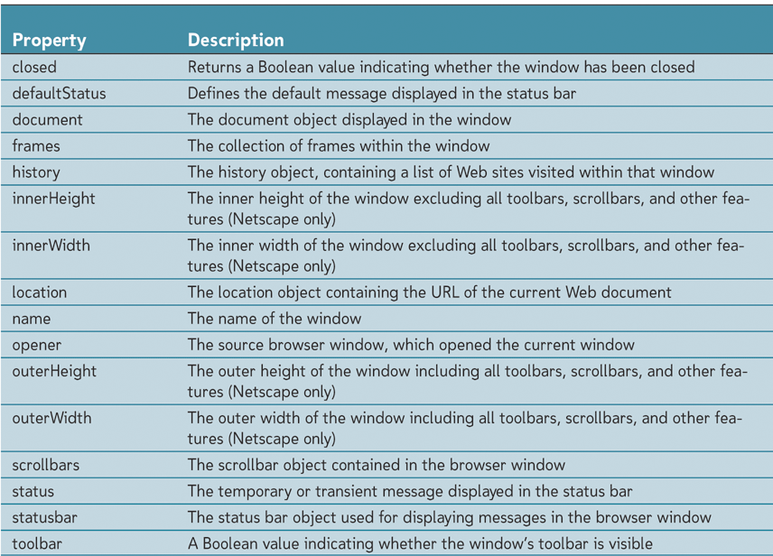
Working with the Window Object
JavaScript considers the browser window an object, which it calls the window object
Tutorial 13
New Perspectives on HTML, XHTML, and DHTML, Comprehensive
‹#›

Slide 7
Working with the Window Object
To set a property of the window object
windowObject.property = “value”
In some cases, can leave the window object reference out
window.innerHeight = “300”;
If the property is an object, you can drop the reference to the window
location = “href”
Tutorial 13
New Perspectives on HTML, XHTML, and DHTML, Comprehensive
‹#›

Slide 8
Working with Status Bars
The borders of a browser window, including items such as the toolbars and scrollbars, are collectively referred to as the window’s chrome
Common to all browsers is the status bar
Tutorial 13
New Perspectives on HTML, XHTML, and DHTML, Comprehensive
‹#›

Slide 9
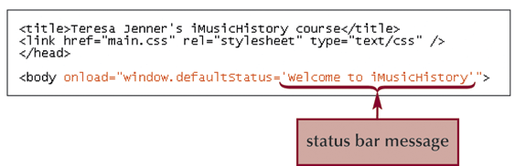
Working with Status Bars
Setting the Default Status Bar Message
The permanent status bar message is the message that appears in the status bar by default
Tutorial 13
New Perspectives on HTML, XHTML, and DHTML, Comprehensive
‹#›

Slide 10
Working with Status Bars
Creating a transient status bar message
A transient status bar message appears only temporarily in response to an event occurring within the browser
windowObject.status=“text”;
return true;
Transient status bar messages remain until some other event replaces them
Tutorial 13
New Perspectives on HTML, XHTML, and DHTML, Comprehensive
‹#›

Slide 11
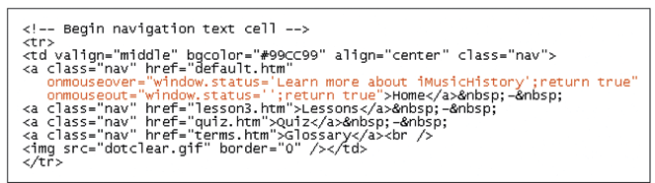
Working with Status Bars
Creating a transient status bar message
Tutorial 13
New Perspectives on HTML, XHTML, and DHTML, Comprehensive
‹#›

Slide 12
Working with the History and Location Objects
The location object contains information about the page that is currently displayed in the window
The history object holds a list of the sites the Web browser has displayed before reaching the current page in the window
Tutorial 13
New Perspectives on HTML, XHTML, and DHTML, Comprehensive
‹#›

Slide 13
Working with the History and Location Objects
Moving Forward and Backward in the History List
history.back();
history.forward();
windowObject.history.back();
To go to a particular page in the history
history.go(integer);
Tutorial 13
New Perspectives on HTML, XHTML, and DHTML, Comprehensive
‹#›

Slide 14
Working with the History and Location Objects
Automatic Page Navigation
Two ways to redirect the user
One way is to add a command to the <meta> tag
The other is to create a JavaScript program that runs when the page is loaded and opens the new page automatically
<meta http-equiv =”Refresh” content=“sec”;URL=“url” />
windowObject.location.href = “url”;
Tutorial 13
New Perspectives on HTML, XHTML, and DHTML, Comprehensive
‹#›

Slide 15
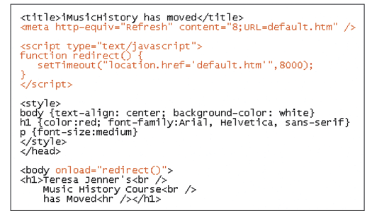
Working with the History and Location Objects
Automatic Page Navigation
Tutorial 13
New Perspectives on HTML, XHTML, and DHTML, Comprehensive
‹#›

Slide 16
Working with the History and Location Objects
Security Issues
Netscape (version 4.0 and above) uses signed scripts to request permission to access restricted information
Signed scripts are not available in Internet Explorer and prior to Netscape version 4, these properties were not available at all from a script
Tutorial 13
New Perspectives on HTML, XHTML, and DHTML, Comprehensive
‹#›

Slide 17
Creating New Browser Windows
Windows that open in addition to the main browser window are called secondary windows or pop-up windows
Tutorial 13
New Perspectives on HTML, XHTML, and DHTML, Comprehensive
‹#›

Slide 18
Creating New Browser Windows
Opening New Windows with HTML
If you want one of your links to open the target document in a new window, you specify the window name using the target property
<a href=“url” target=“name”>link text</a>
Tutorial 13
New Perspectives on HTML, XHTML, and DHTML, Comprehensive
‹#›

Slide 19
Creating New Browser Windows
Opening New Windows with JavaScript
The JavaScript command to create a new browser window is
window.open(“url”,”name”,”features”)
Tutorial 13
New Perspectives on HTML, XHTML, and DHTML, Comprehensive
‹#›

Slide 20
Creating New Browser Windows
Setting the Features of a Pop-up Window
The feature list obeys the following syntax:
“feature1=value1, feature2=value2…featureN=valueN”
Tutorial 13
New Perspectives on HTML, XHTML, and DHTML, Comprehensive
‹#›

Slide 21
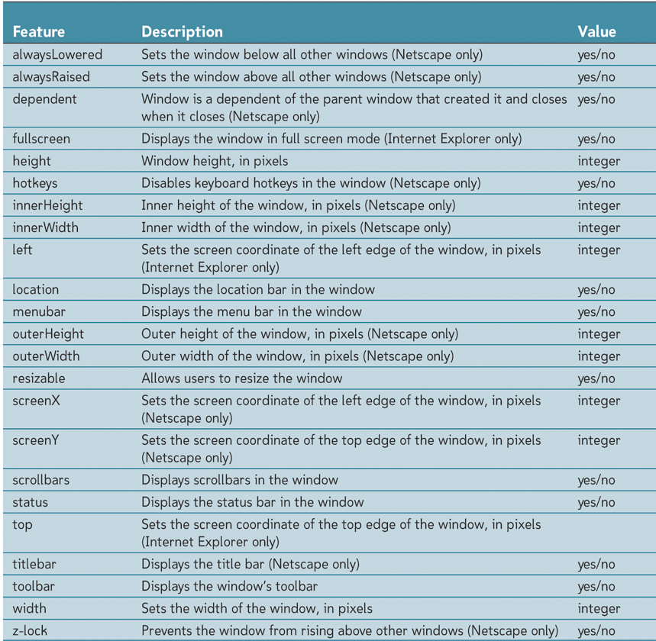
Creating New Browser Windows
Setting the Features of a Pop-up Window
Tutorial 13
New Perspectives on HTML, XHTML, and DHTML, Comprehensive
‹#›

Slide 22
Creating New Browser Windows
Working with Pop-up Blockers
Pop-up blockers prevent pop-up windows from opening
You can have the browser check whether the pop-up window has been opened or not
Tutorial 13
New Perspectives on HTML, XHTML, and DHTML, Comprehensive
‹#›

Slide 23
Creating New Browser Windows
Working with Pop-up Blockers
function popWin(url) {
windowObj = window.open(“url”,”name”,”features”);
test=(windowObj==null ||
typeof(windowObj)==“undefined) ? true : false;
return test;
}
<a href=“url” onclick=“return(popWin(“url”))”>Link Text</a>
Tutorial 13
New Perspectives on HTML, XHTML, and DHTML, Comprehensive
‹#›

Slide 24
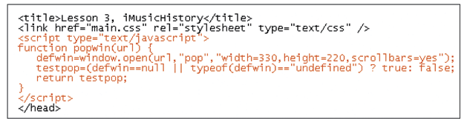
Creating New Browser Windows
Adding a Pop-up Window to the iMusicHistory Site
Tutorial 13
New Perspectives on HTML, XHTML, and DHTML, Comprehensive
‹#›

Slide 25
Creating New Browser Windows
Window Security Issues
A browser’s ability to open new windows on a user’s computer raises some security issues
For example, you cannot create a new window with a width and height less than 100 pixels
Tutorial 13
New Perspectives on HTML, XHTML, and DHTML, Comprehensive
‹#›

Slide 26
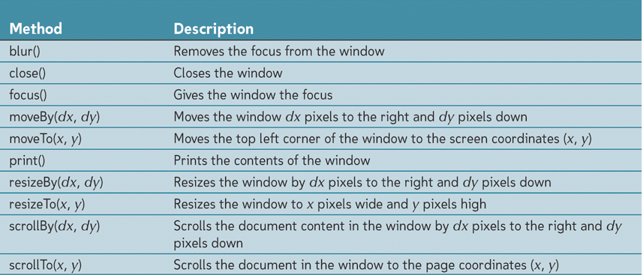
Working with Window Methods
Window Methods
Tutorial 13
New Perspectives on HTML, XHTML, and DHTML, Comprehensive
‹#›

Slide 27
Working with Window Methods
The Self and Opener Keywords
The self keyword refers to the current window
Self keyword is synonymous with the window keyword, but you may see it used to improve clarity
The opener keyword refers to the window or frame that used the window.open() method to open the current window
Tutorial 13
New Perspectives on HTML, XHTML, and DHTML, Comprehensive
‹#›

Slide 28
Creating Dialog Boxes
An alert dialog box displays a message along with an OK button
A prompt dialog box displays both a message and a text box in which the user can enter text
A confirm dialog box displays a message along with OK and cancel buttons
Tutorial 13
New Perspectives on HTML, XHTML, and DHTML, Comprehensive
‹#›

Slide 29
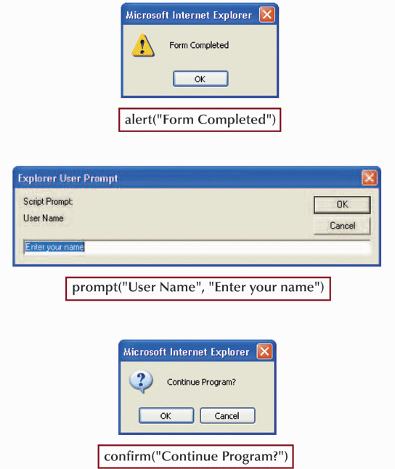
Creating Dialog Boxes
Tutorial 13
New Perspectives on HTML, XHTML, and DHTML, Comprehensive
‹#›

Slide 30
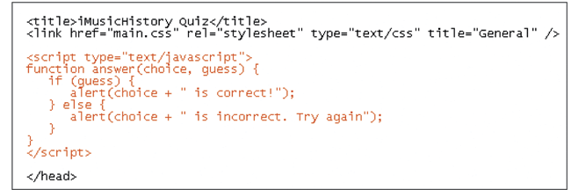
Creating Dialog Boxes
Tutorial 13
New Perspectives on HTML, XHTML, and DHTML, Comprehensive
‹#›

Slide 31
Working between Windows
Writing Content to a Window
To write content to a pop-up-window, you use the document.write() method
windowObject.document.write(“Content”);
Tutorial 13
New Perspectives on HTML, XHTML, and DHTML, Comprehensive
‹#›

Slide 32
Working between Windows
Accessing an Object within a Window
Once you specify a window object, you can work with the objects contained in the window’s document
windowObject.document.getElementById(id);
windowObject.variable
windowObject.function()
Tutorial 13
New Perspectives on HTML, XHTML, and DHTML, Comprehensive
‹#›

Slide 33
Working with Modal and Modeless Windows
A modal window is a window that prevents users from doing work in any other window or dialog box until the window is closed
A modeless window allows users to work in other dialog boxes and windows even if the window stays open
windowObject.showModalDialog(“url”, “arguments”, “features”)
windowObject.showModelessDialog(“url”, “arguments”, “features”)
Tutorial 13
New Perspectives on HTML, XHTML, and DHTML, Comprehensive
‹#›

Slide 34
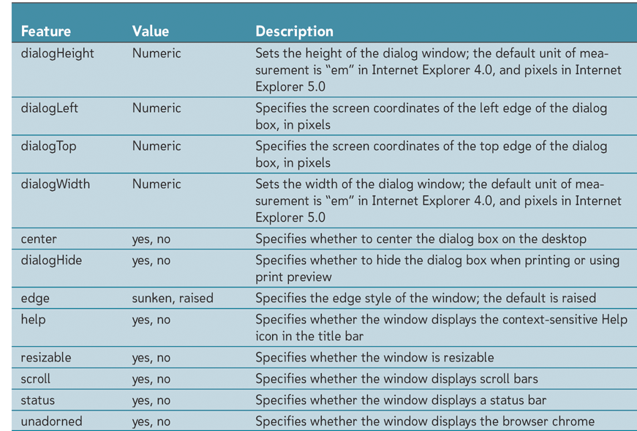
Working with Modal and Modeless Windows
Working with the Features List
Tutorial 13
New Perspectives on HTML, XHTML, and DHTML, Comprehensive
‹#›

Slide 35
Working with Modal and Modeless Windows
Exchanging Information between the Windows
Neither the showModalDialog() nor the showModelessDialog() methods allow direct interaction between the calling browser window and the pop-up window
If you need to send information, you must include that data in the arguments parameter for the method
Tutorial 13
New Perspectives on HTML, XHTML, and DHTML, Comprehensive
‹#›

Slide 36
Working with Frames
The name attribute of a frame is used when creating links whose targets are designed to appear in specific frames
To reference a specific frame in you JavaScript code, you need to use the id attribute
<frame id=“top” name=“top” src=“home.htm” />
Tutorial 13
‹#›

Slide 37
Working with Frames
Working with the frame and frameset objects
Each frame in a frameset is part of the frames collection
windowObject.frames[idref]
To reference the header frame
window.frames[0]
window.framses[“header”]
Tutorial 13
New Perspectives on HTML, XHTML, and DHTML, Comprehensive
‹#›

Slide 38
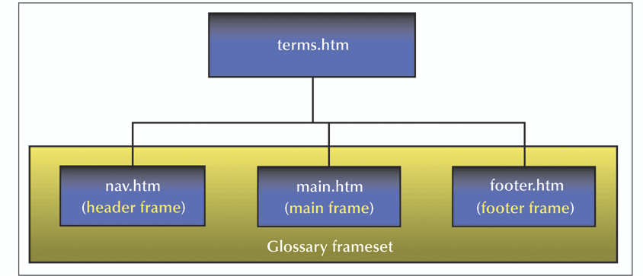
Working with Frames
Navigating between frames
JavaScript treats the frames in a frameset as elements in a hierarchical tree
Tutorial 13
New Perspectives on HTML, XHTML, and DHTML, Comprehensive
‹#›

Slide 39
Working with Frames
Navigating between frames
The parent keyword refers to any object that is placed immediately above another object in the hierarchy
If you want to go directly to the top of the hierarchy, you can use the top keyword
Tutorial 13
New Perspectives on HTML, XHTML, and DHTML, Comprehensive
‹#›

Slide 40
Working with Frames
Treating frames as windows
In most cases JavaScript treats a frame as a separate browser window
frameObject.document.write(content)
frameObject.document.close()
frameObject.location.href = “url”
Tutorial 13
New Perspectives on HTML, XHTML, and DHTML, Comprehensive
‹#›

Slide 41
Working with Frames
Setting the frameset layout
In JavaScript
frameset.rows = “text”
frameset.cols = “text”
Tutorial 13
New Perspectives on HTML, XHTML, and DHTML, Comprehensive
‹#›

Slide 42
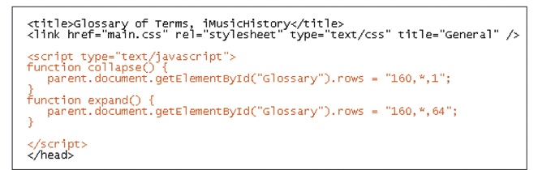
Working with Frames
Collapsing and expanding a frame
Tutorial 13
New Perspectives on HTML, XHTML, and DHTML, Comprehensive
‹#›

Slide 43
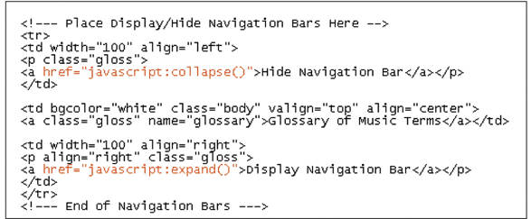
Working with Frames
Collapsing and expanding a frame
Tutorial 13
New Perspectives on HTML, XHTML, and DHTML, Comprehensive
‹#›

Slide 44
Working with Inline Frames
Another way to use frames in a Web site is by incorporating an inline frame
<iframe src=“url” id=“text” name=“text” width=“value” height=“value”>alternate content</iframe>
You can reference it from the current document window using the object reference or as a frame using the frames reference
Tutorial 13
New Perspectives on HTML, XHTML, and DHTML, Comprehensive
‹#›

Slide 45
Tips for Working with Windows and Frames
If you use JavaScript to write a transient status bar message, be sure to properly erase the message
Keep the use of pop-up windows to minimum, and forewarn your users if possible
Include code to verify that a pop-up window has not been blocked and, if possible, provide alternate methods
Tutorial 13
New Perspectives on HTML, XHTML, and DHTML, Comprehensive
‹#›

Slide 46
Tips for working with windows and frames
Include code that makes it easy for users to close your pop-up windows
Allow your users to resize your pop-up windows
If the existence of pop-up blockers poses a problem, consider using alert, prompt, and confirm dialog boxes in place of pop-up windows
Tutorial 13
New Perspectives on HTML, XHTML, and DHTML, Comprehensive
‹#›

Slide 47
Tips for working with windows and frames
If frames are a concern, add conditional statements to your documents to prevent them from appearing within the framesets of other Web sites
Add JavaScript code to your frame documents so that they always appear within the context of their framesets
Tutorial 13
New Perspectives on HTML, XHTML, and DHTML, Comprehensive
‹#›

